Slide 1
ĐH Bách Khoa - ĐHQG TP.HCM
- chithong@hcmut.edu.vn
The 8051 Microcontroller
Chapter 2 Hardware Summary
Ref. I. Scott Mackenzie, The 8051 Microcontroller

Slide 2
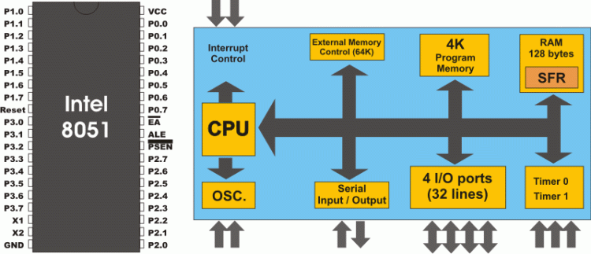
Features of 8051
4KB ROM
128 bytes RAM
Four 8-bit I/O ports
Two 16-bit timers
Serial interface
64KB external code memory space
64KB external _{L}d_{ê}a_{Ch}ta_{í Th}m_{ông}emory space
Ref. I. Scott Mackenzie
2

Slide 3
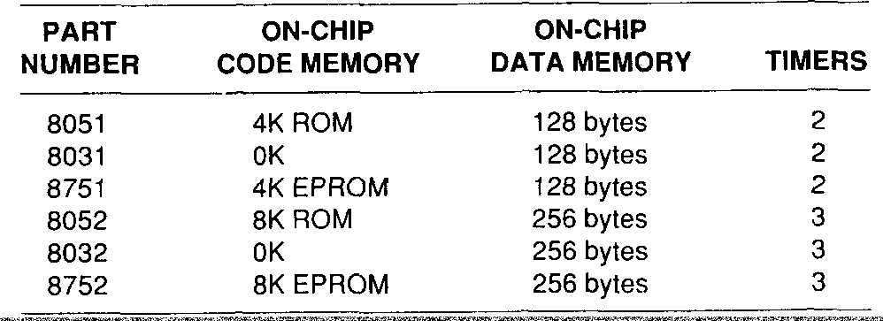
ĐH Bách Khoa - ĐHQG TP.HCM
- chithong@hcmut.edu.vn
Comparison of MCS-51 Family
Ref. I. Scott Mackenzie
3

Slide 4
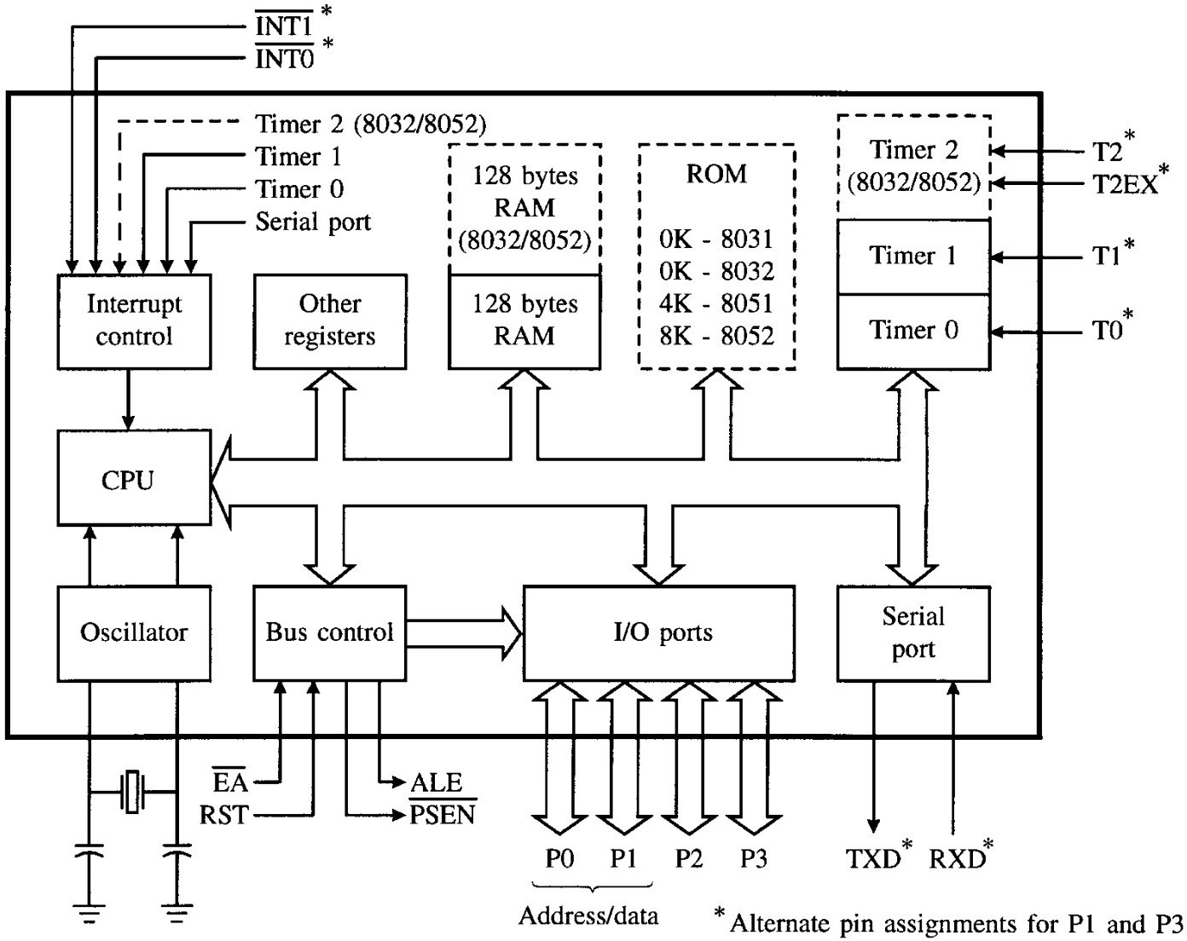
PSEN’ - use external Program memory ALE – Address/Data multiplexing
EA’ – 5V for internal ROM, 0V for external ROM
FIGURE 2–1 8051 block diagram
Ref. I. Scott Mackenzie
4

Slide 5
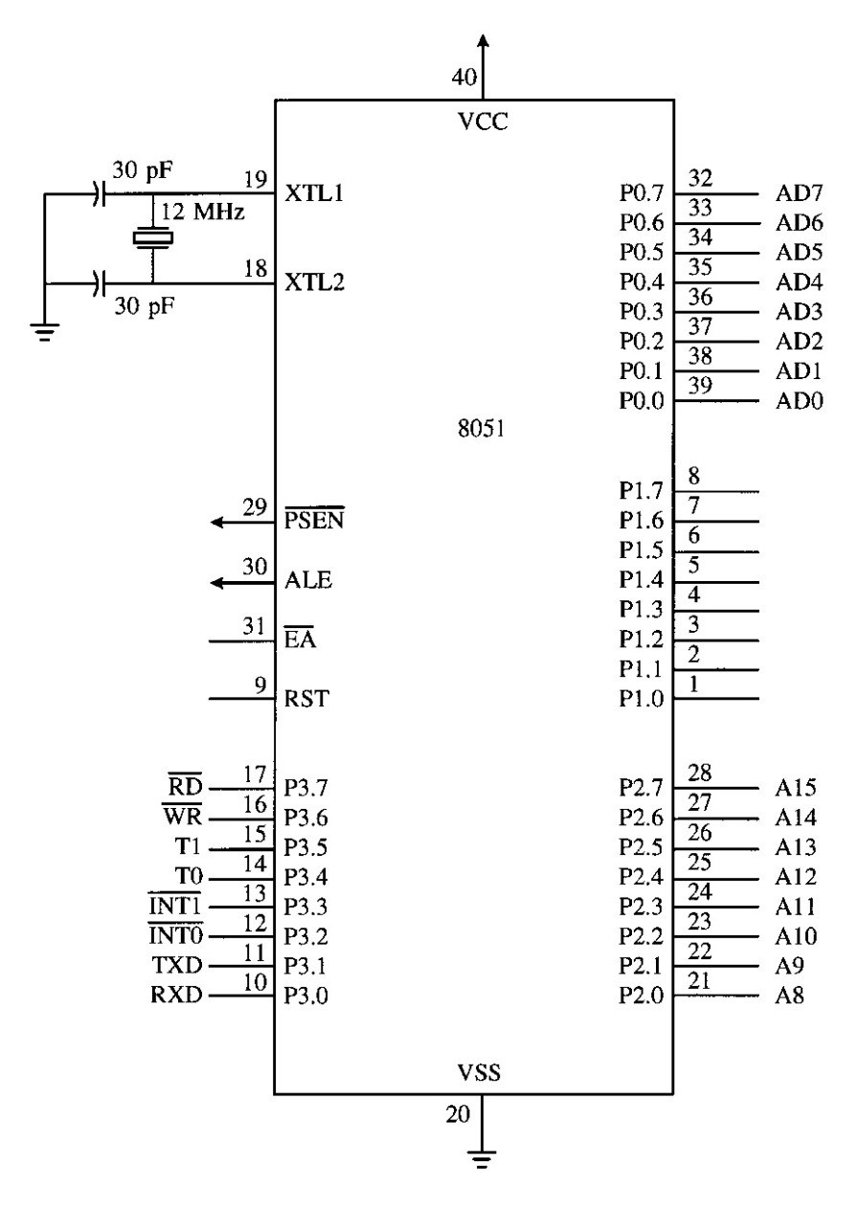
ĐH Bách Khoa - ĐHQG TP.HCM
- chithong@hcmut.edu.vn
Address/Data Buses Multiplexing
Parallel I/O
Serial I/O
FIGURE 2–2 80
Ref. I. Scott Mackenzie
51 pinouts
5

Slide 6
Around The Pins
Port 0: dual purpose
I/O port
Multiplexed address and data bus (AD0-AD7)
Port 1: I/O port
Port 2: dual purpose
I/O port
High-byte address bus (A8-A15)
Ref. I. Scott Mackenzie
6

Slide 7
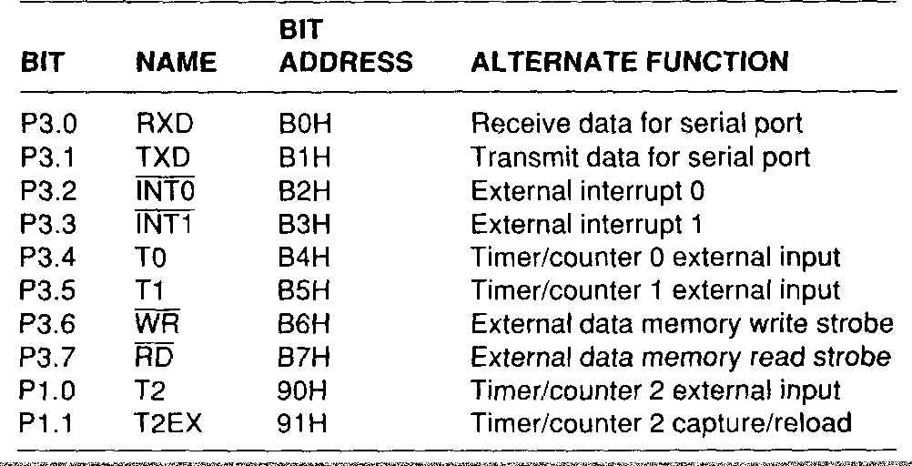
ĐH Bách Khoa - ĐHQG TP.HCM
- chithong@hcmut.edu.vn
Port 3: dual purpose
Ref. I. Scott Mackenzie
7

Slide 8
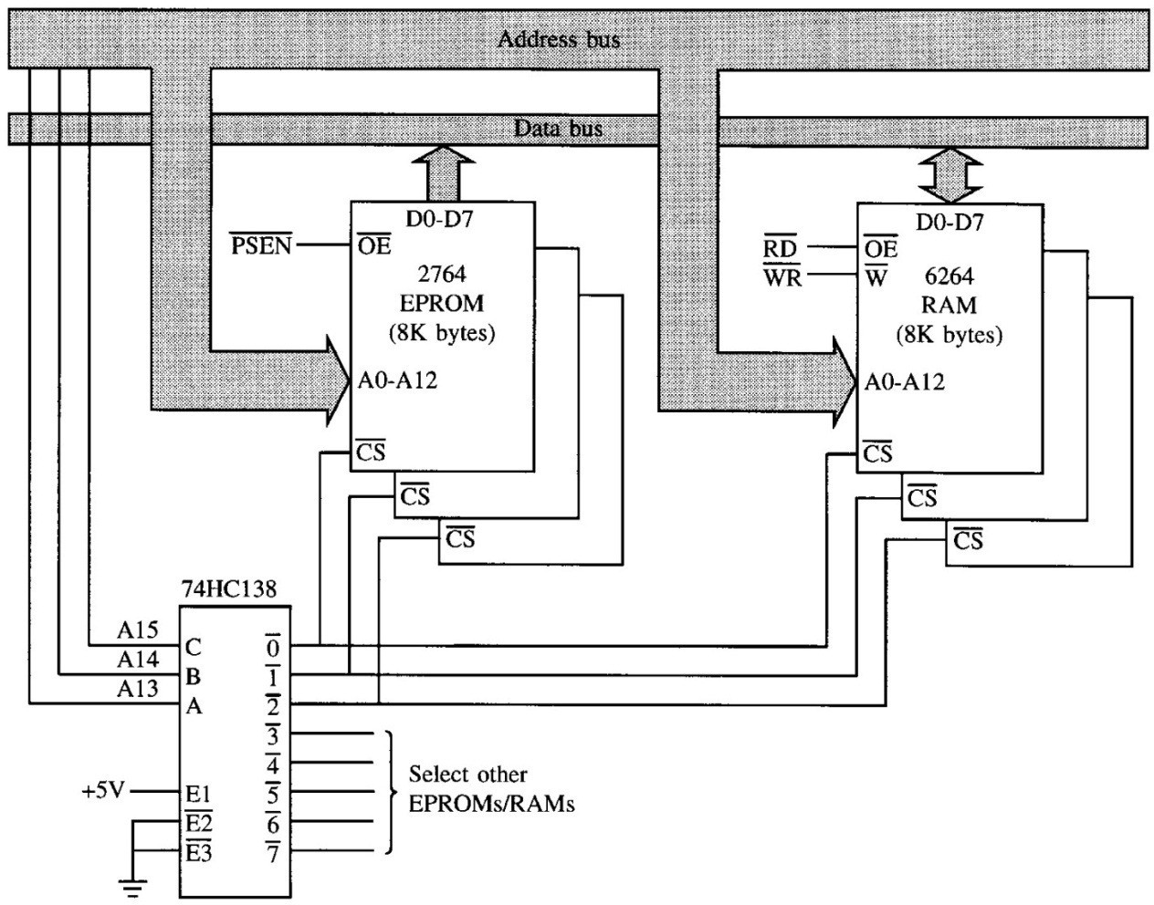
/PSEN (Program Store Enable)
o Connects to /OE (Output Enable) of EPROM to permit reading of program bytes
Ref. I. Scott Mackenzie
8

Slide 9
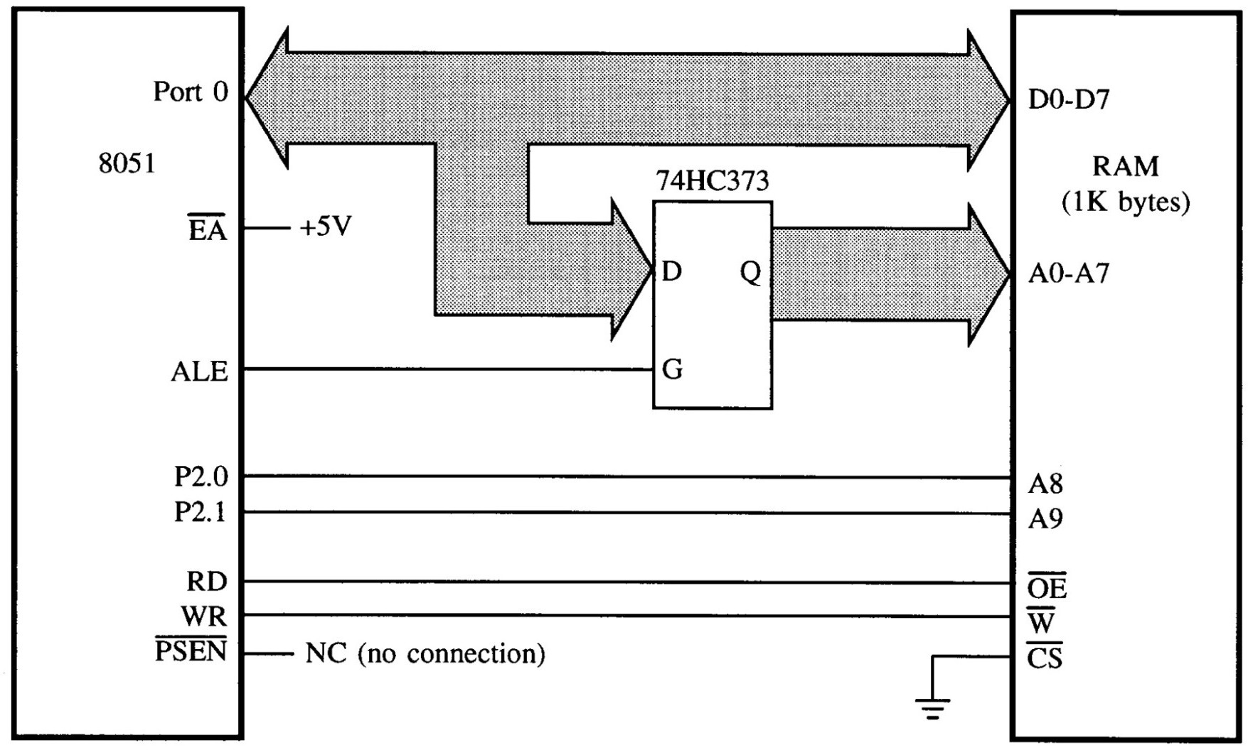
ĐH Bách Khoa - ĐHQG TP.HCM
- chithong@hcmut.edu.vn
ALE (Address Latch Enable)
o Use to demultiplex the address and data bus
Ref. I. Scott Mackenzie
9

Slide 10
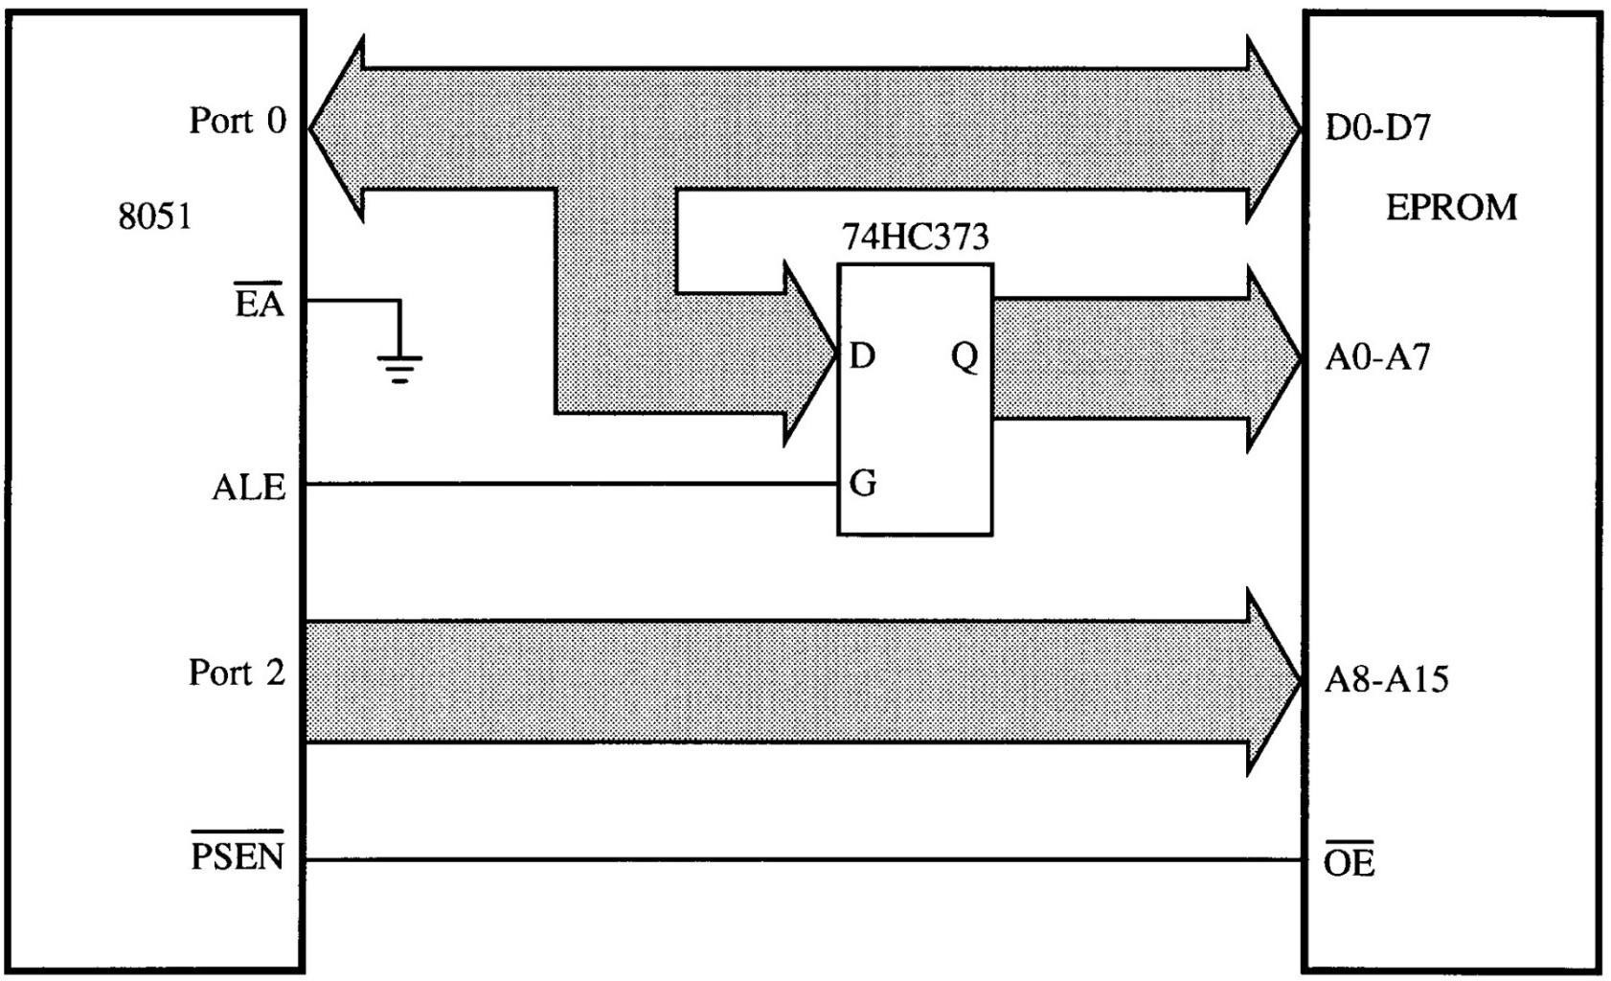
/EA (External Access) It is tied to +5V or ground.
/EA = +5V: executes programs from internal ROM
/EA = 0V: executes programs from external ROM
Ref. I. Scott Mackenzie
10

Slide 11
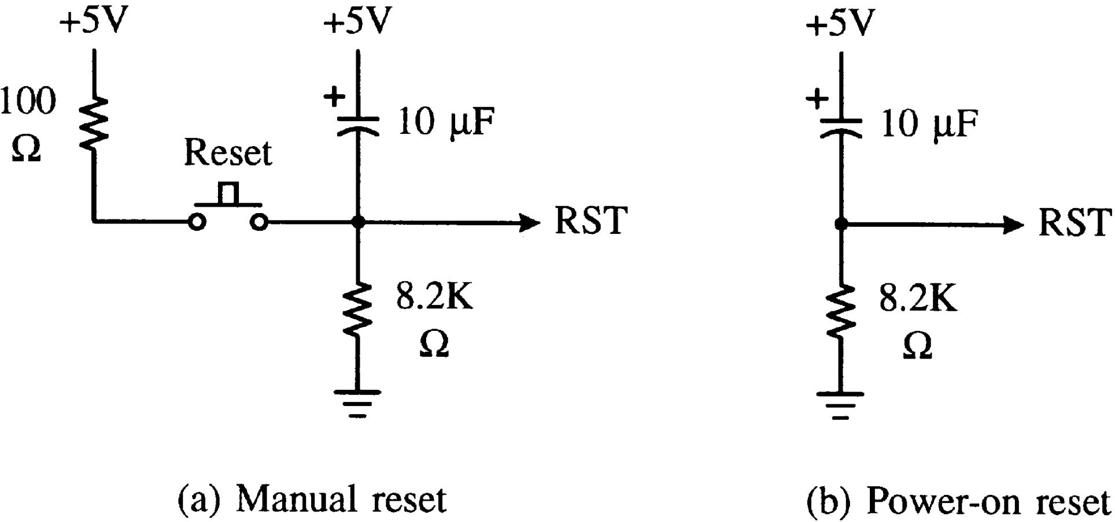
ĐH Bách Khoa - ĐHQG TP.HCM
- chithong@hcmut.edu.vn
RST (Reset):
Ref. I. Scott Mackenzie
11

Slide 12
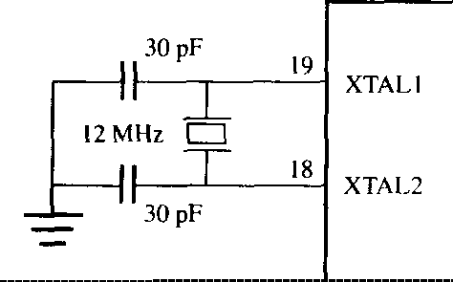
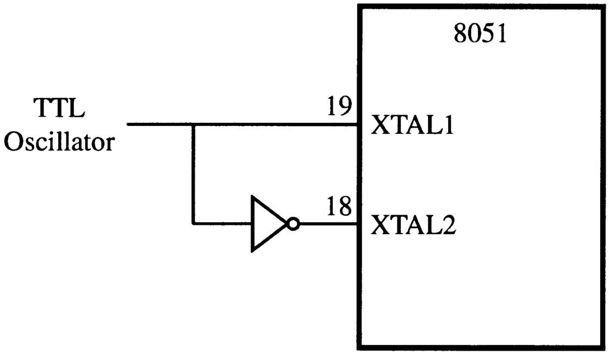
XTAL1 , XTAL2: On-chip oscillator inputs
Ref. I. Scott Mackenzie
12

Slide 13
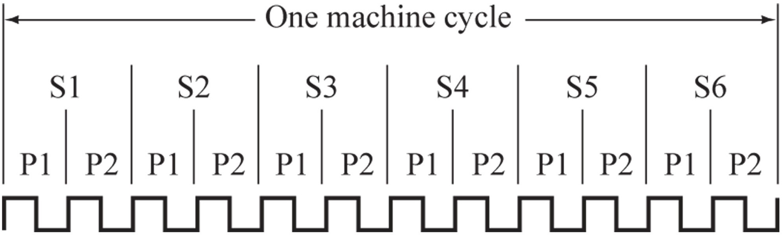
ĐH Bách Khoa - ĐHQG TP.HCM
- chithong@hcmut.edu.vn
FIGURE 2–5 Relationship between oscillator clock cycles, states, and the machine cycle
A machine cycle is 12 oscillator periods. Use 12 MHz crystal: a machine cycle is 1 µs
Ref. I. Scott Mackenzie
13

Slide 14
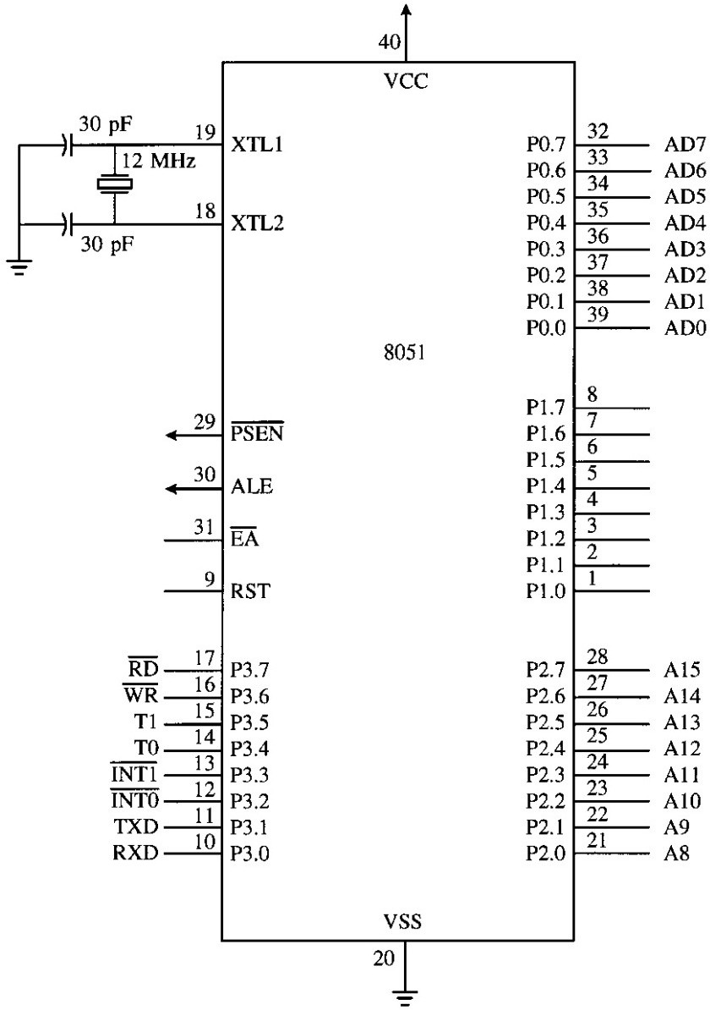
V_{dd}, V_{ss}: Power connections
V_{dd} is connected to +5V
V_{ss} is connected to ground (0V)
Ref. I. Scott Mackenzie
14

Slide 15
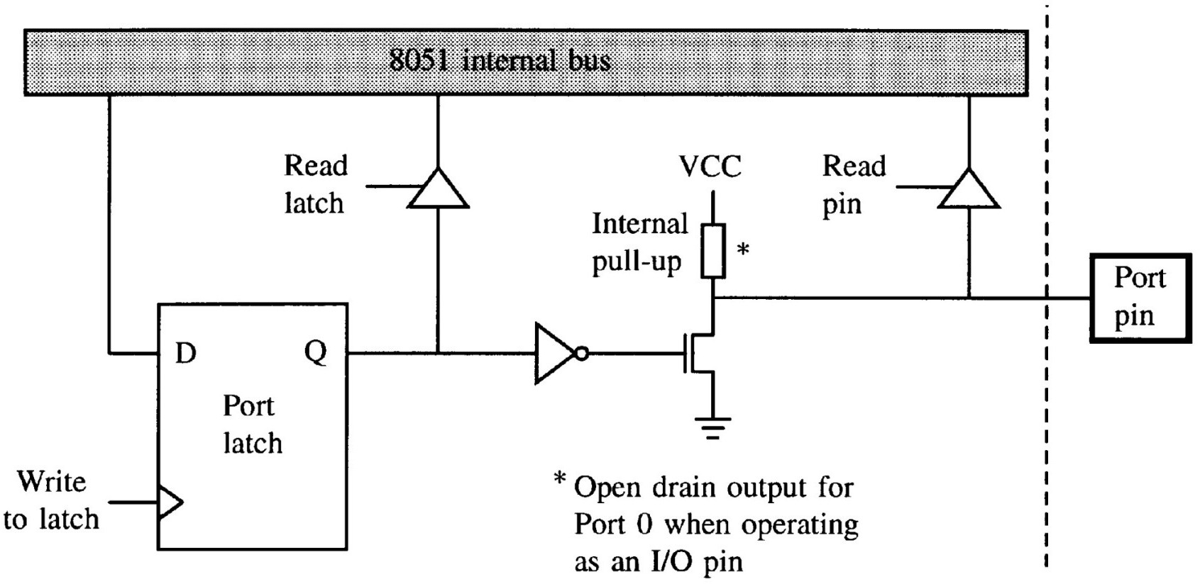
ĐH Bách Khoa - ĐHQG TP.HCM
- chithong@hcmut.edu.vn
I/O Port Structure
Port 1, 2, and 3 have internal pull-up resistors.
Port 0 has no internal pull-up resistors.
Instructions that input a port bit require the ‘1’ port latch.
Don’t need Bus-driver
Ref. I. Scott Mackenzie
15

Slide 16
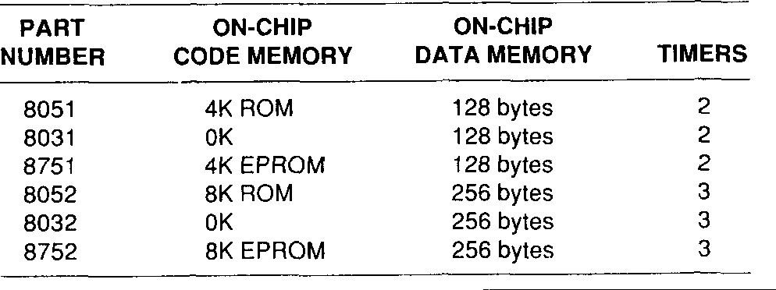
Memory Organization
Memory
ROM: for program (code) € Code memory
External: maximum 64K
Internal (on-chip): depend on chips
RAM: for data € Data memory
External: maximum 64K
Internal (on-chip): depend on chips
Ref. I. Scott Mackenzie
16

Slide 17
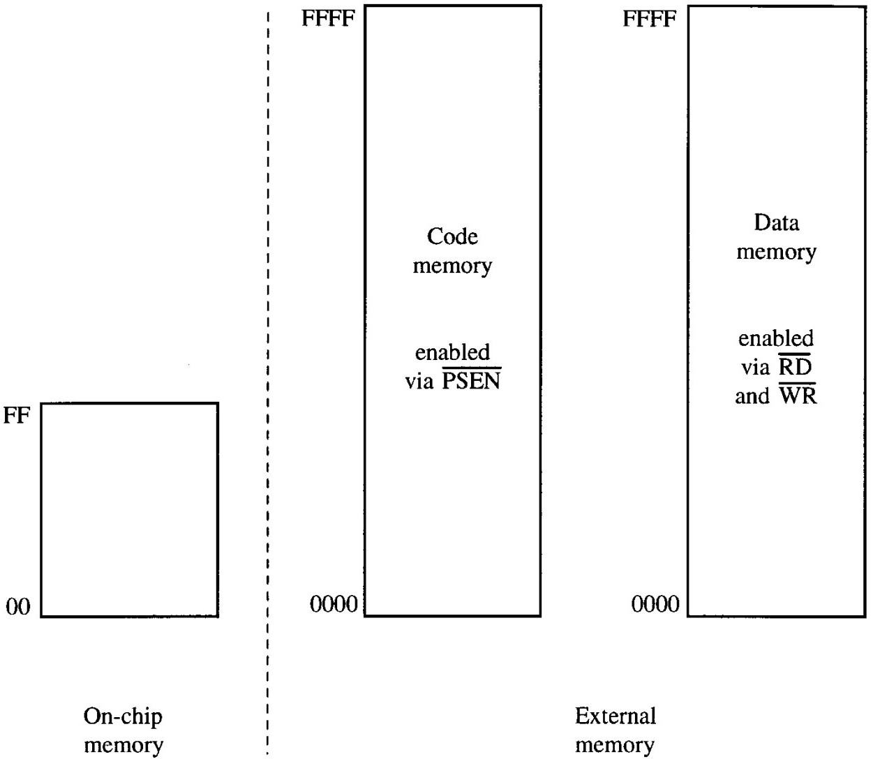
ĐH Bách Khoa - ĐHQG TP.HCM
- chithong@hcmut.edu.vn
FIGURE 2–6 Summary of the 8031 memory spaces
Memory Map
256-byte
64-Kbyte
Ref. I. Scott Mackenzie
17

Slide 18
Internal (on-chip) data memory
Register banks (00H-1FH)
Bit-addressable RAM (20H-2FH)
General-purpose RAM (30H-7FH)
Special function registers (80H-FFH)
Ref. I. Scott Mackenzie
18

Slide 19
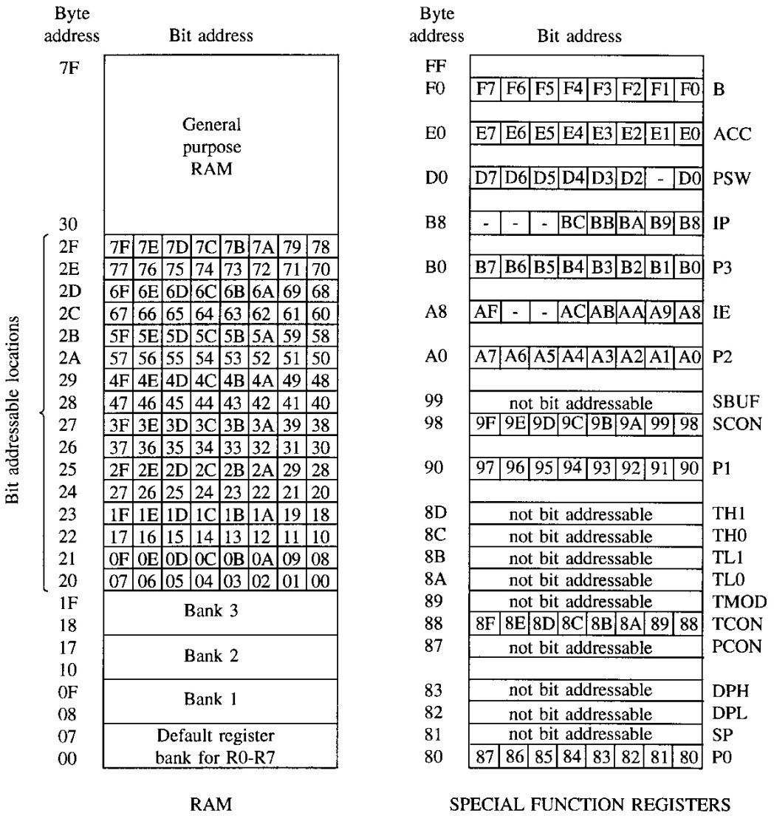
ĐH Bách Khoa - ĐHQG TP.HCM
- chithong@hcmut.edu.vn
Internal (on-chip) data memory:
General purpose RAM
(30H-7FH)
Using for MUL,DIV
Bit-addressable RAM
(20H-2FH)
Register banks (00H-1FH)
DPTR
Special function registers (80H-FFH)
Ref. I. Scott Mackenzie
19

Slide 20
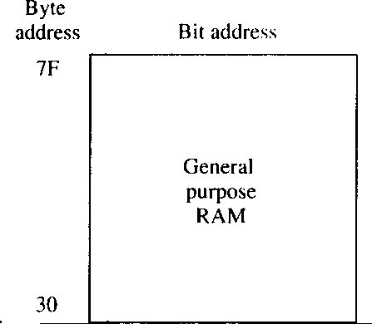
General purpose RAM
80 bytes from addresses 30H to 7FH
Accessed using direct or indirect addressing modes Ex:
Direct
MOV A, 5FH
Indirect
MOV R0, #5FH MOV A, @R0
Ref. I. Scott Mackenzie
20

Slide 21
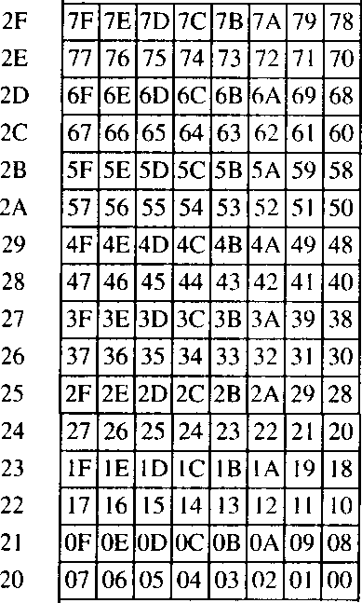
ĐH Bách Khoa - ĐHQG TP.HCM
- chithong@hcmut.edu.vn
Bit-addressable RAM
16 bytes from (byte) addresses 20H to 2FH
128 bits from bit addresses 00H to 7FH
Bit can be set, cleared, ANDed, ORed, … Ex:
To set bit 67H
SETB 67H
or
MOV A, 2CH
ORL A, #10000000B MOV 2CH, A
Ref. I. Scott Mackenzie
21

Slide 22
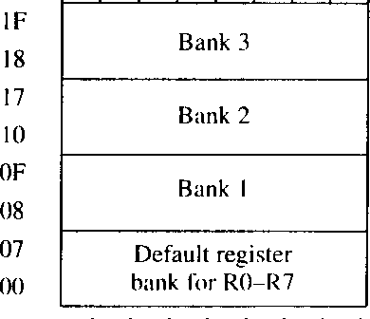
Register banks
Bank 0 (default), Bank 1, Bank 2, and Bank 3
Change register bank by selecting bits RS1 and RS0 the program status word
One bank includes 8 registers: R0 through R7 Ex:
Read the contents of location 05H into the accumulator
MOV A, R5
or
MOV A, 05H
Write the contents of the accumulator into location 00H
MOV R0, A
Ref. I. Scott Mackenzie
22

Slide 23
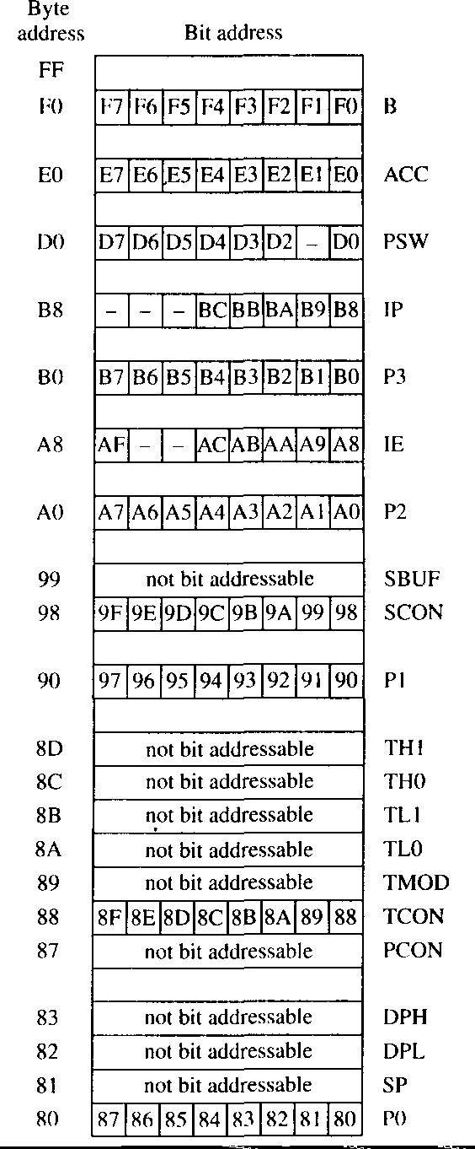
ĐH Bách Khoa - ĐHQG TP.HCM
- chithong@hcmut.edu.vn
Special Function Registers
Program Status Word (PSW)
A and B registers
Stack Pointer (SP)
Data Pointer DPTR = DPH:DPL
Port Registers (P0, P1, P2, P3)
Timer Registers (TMOD, TCON, Timer1=TH1:TL1, Timer0 = TH0:TL0)
Serial Port Registers (SCON, SBUF)
Interrupt Register (IE, IP)
Power Control Register (PCON)
Ref. I. Scott Mackenzie
23

Slide 24
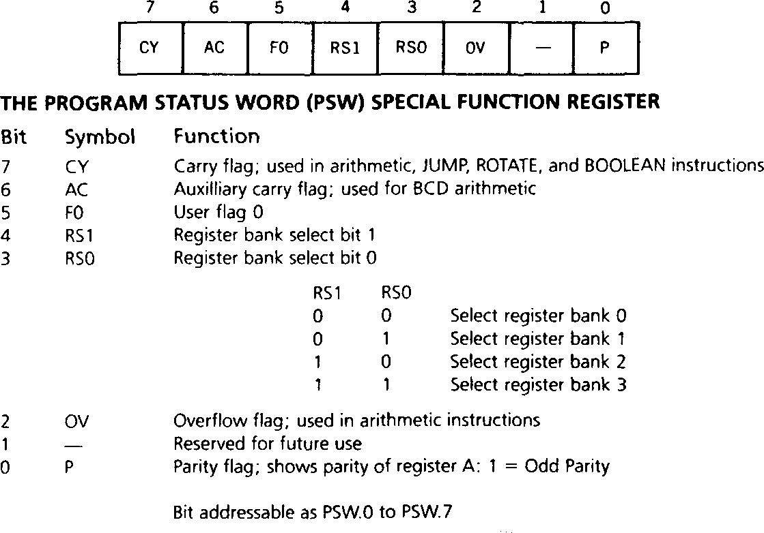
Program Status Word (PSW)
Ref. I. Scott Mackenzie
24

Slide 25
ĐH Bách Khoa - ĐHQG TP.HCM
A and B Register
A (accumulator) register (Address E0H)
The most versatile register
Used for many operations (addition, subtraction, multiplication, division, Boolean bit manipulations, …)
B register (Address F0H)
Used with the A register for multiplication and division
Ex: To multiply the 8-bit unsigned values in A and B and leaves the 16-bit result in A (low-byte) and B (high-byte)
MUL AB
To divide A by B and leaves the integer result in A and the remainder in B
DIV AB
Ref. I. Scott Mackenzie
25

Slide 26
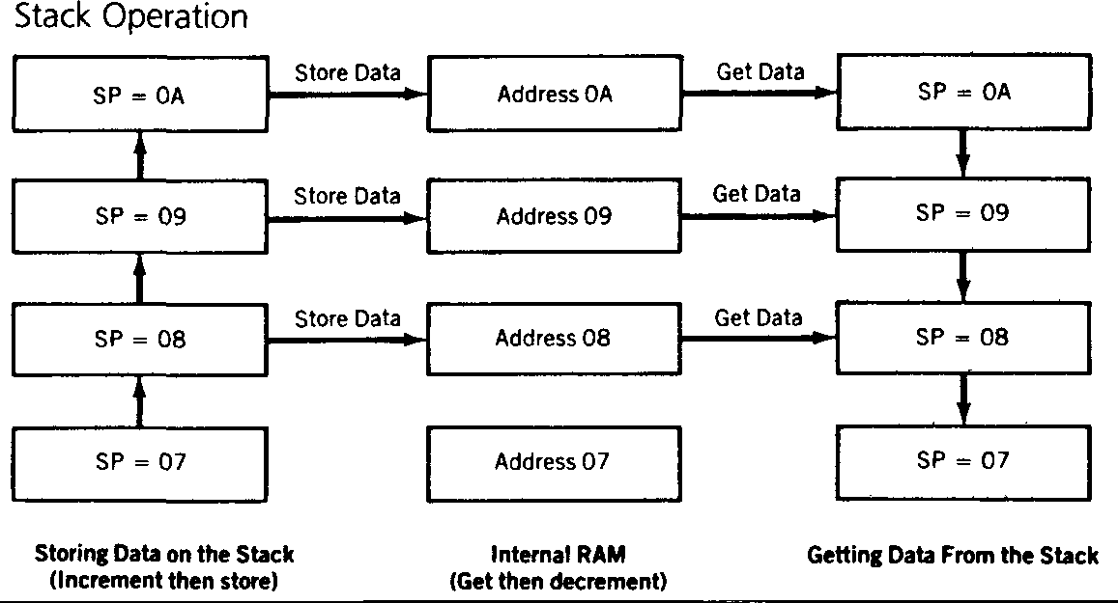
Stack Pointer (SP) (Address 81H)
Used to access the stack
PUSH: SP increases before storing data on the stack
POP: data is read from the stack and then SP decreases
The reset value of SP is 07H € Stack is from 08H
LIFO: Last In First Out
Ex: To set the stack beginning at 60H
MOV SP,#5FH
To store data from R1 register into stack
PUSH 01H
To retrieve data from stack to register R2
POP 02H
Ref. I. Scott Mackenzie
26

Slide 27
ĐH Bách Khoa - ĐHQG TP.HCM
- chithong@hcmut.edu.vn
Stack Pointer (SP) (Address 81H)
Ex: MOV R1,#15H MOV R3,#0FH MOV R7,#0E9H PUSH 01H
PUSH 03H PUSH 07H
… MOV MOV MOV
…
POP 07H
POP 03H
POP 01H
R1
15H
R3
0FH
R7
E9H
0AH
09H
08H SP=07H
0AH
09H SP=08H
07H
15H
0AH
0FH
15H
SP=0AH
09H
08H
07H
E9H
0FH
15H
R1,#67H R3,#0D8H R7,#63H
SP=09H
08H
07H
R1
67H
R3
D8H
R7
63H
R1 15H
R3
0FH
R7
E9H
Ref. I. Scott Mackenzie
27

Slide 28
Stack Pointer (SP) (Address 81H)
Ex: MOV R1,#15H MOV R3,#0FH PUSH 01H PUSH 03H
POP 01H
POP 03H
R1
15H
R3
0FH
0AH
09H
08H SP=07H
0AH
09H SP=08H
07H
15H
0AH SP=09H
08H
07H
0FH
15H
R1
0FH
R3
15H
Ref. I. Scott Mackenzie
28

Slide 29
ĐH Bách Khoa - ĐHQG TP.HCM
- chithong@hcmut.edu.vn
Data Pointer (DPTR) (Addresses 82H & 83H)
Used to access external code or data memory
DPTR is 16-bit register, including DPH (high-byte) and DPL
(low-byte)
Ex: To write 55H into external RAM location 1000H
MOV A,#55H MOV DPTR,#1000H
MOVX @DPTR,A
Ref. I. Scott Mackenzie
29

Slide 30
Port Register
P0, P1, P2, and P3 registers
Used to access I/O ports
Ports 0, 2, and 3 may not available for I/O if external memory is used or if some of special features are used (interrupt, …)
All ports are bit-addressable
Ex: To read data from Port 1 into A register
MOV A,P1
To write data from R7 register to Port 2
MOV P2,R7
To set bit 7 of Port 3
SETB P3.7
To clear bit 7 of Port 1
CLR P1.7
or CLR 97H
30
Ref. I. Scott Mackenzie

Slide 31
ĐH Bách Khoa - ĐHQG TP.HCM
- chithong@hcmut.edu.vn
Timer Registers
8051 contains two 16-bit timer/counters: Timer 0 & Timer 1.
Used for timing intervals or counting events
Timer 0 = TH0 (high-byte) & TL0 (low-byte)
Timer 1 = TH1 (high-byte) & TL1 (low-byte)
Timer operation is set by the Timer Mode Register (TMOD) and the Timer Control Register (TCON) (discussed in details in Chapter 4).
Ref. I. Scott Mackenzie
31

Slide 32
Serial Port Registers
8051 contains serial port for communicating with serial devices such as PC (via serial port) or other ICs with serial interface.
The Serial Control Register (SCON) is used to set various modes of operations.
The Serial Buffer Register (SBUF) is used to transmit and receive data.
Writing to SBUF loads data for transmission
Reading SBUF accesses received data (discussed in details in Chapter 5)
Ref. I. Scott Mackenzie
32

Slide 33
ĐH Bách Khoa - ĐHQG TP.HCM
- chithong@hcmut.edu.vn
Interrupt Registers
8051 has a 5-source, 2-priority level interrupt structure.
The Interrupt Register (IE) is used to enable interrupts.
The Interrupt Priority Register (IP) is used to set the priority level.
(discussed in details in Chapter 6)
Ref. I. Scott Mackenzie
33

Slide 34
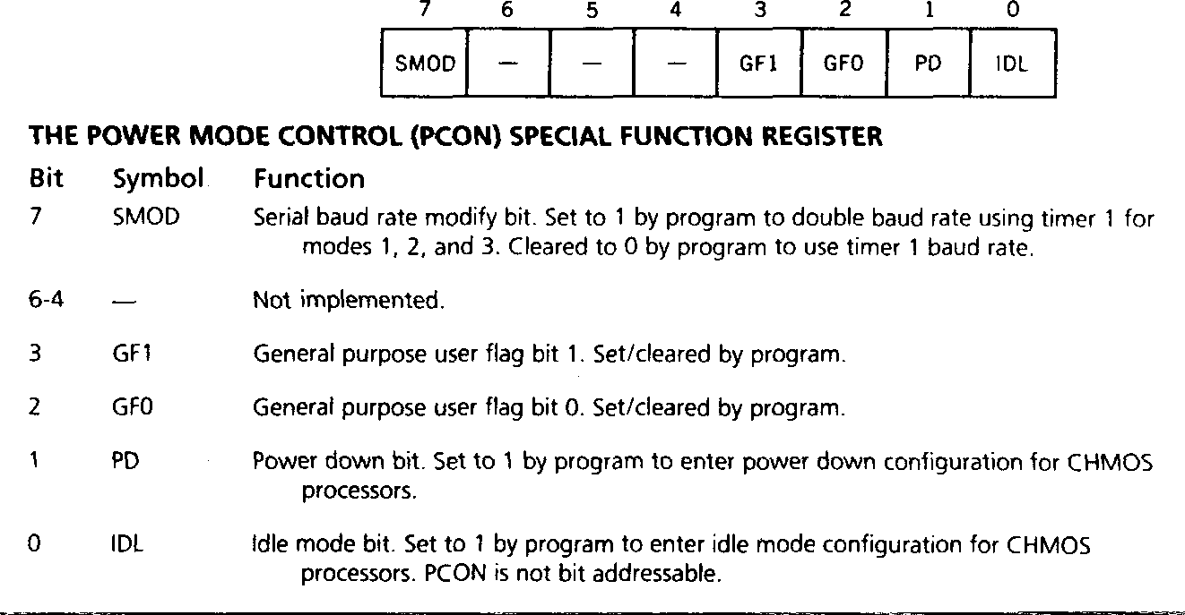
Power Control Register (PCON)
Ref. I. Scott Mackenzie
34

Slide 35
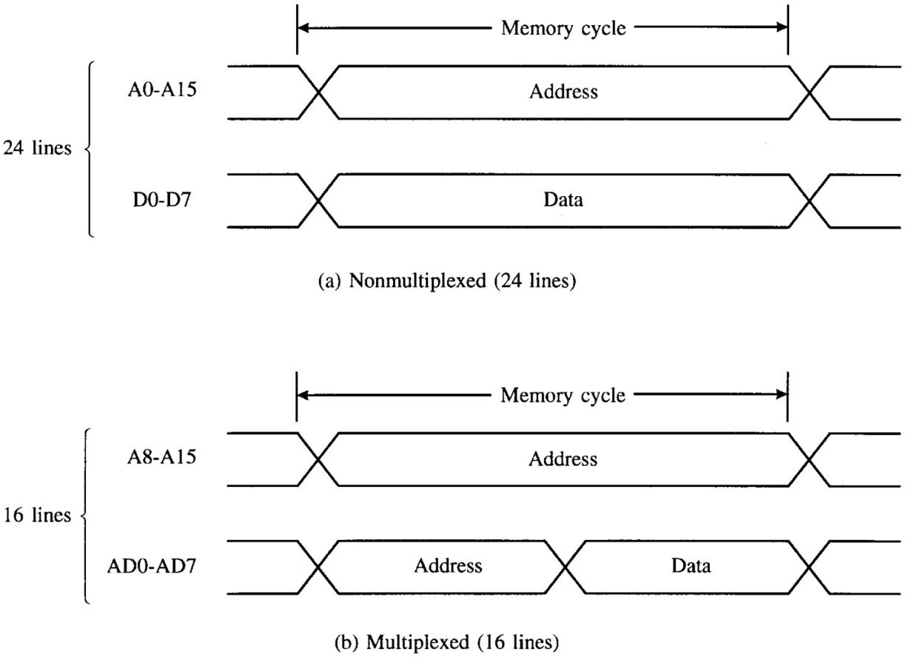
ĐH Bách Khoa - ĐHQG TP.HCM
- chithong@hcmut.edu.vn
External Memory
When external memory is used:
Port 0 is a multiplexed address (A0-A7) & data (D0-D7) bus.
Port 2 is usually the high-byte of address bus (A8-A15)
Ref. I. Scott Mackenzie
35

Slide 36
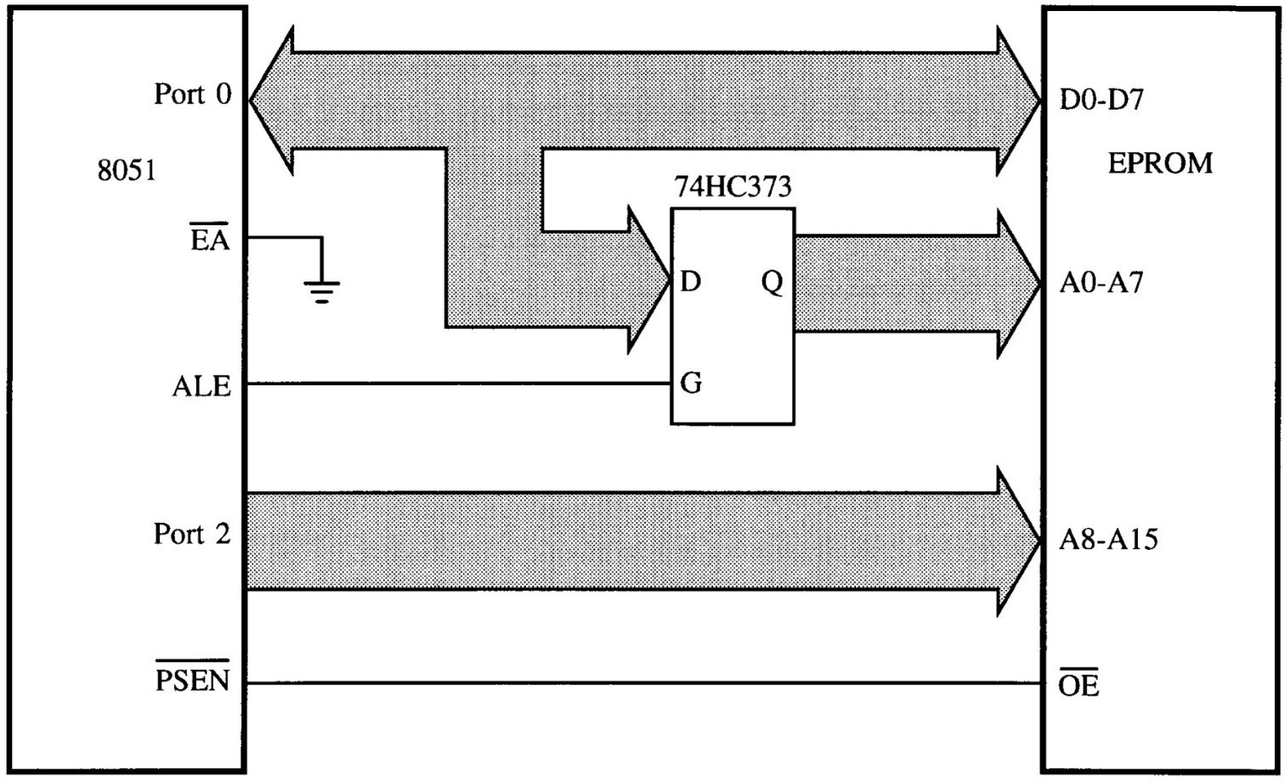
Accessing External Code Memory
External code memory is ROM enabled by /PSEN signal.
Port 0 & Port 2 are unavailable as I/O ports.
Port 0 is AD0-AD7 bus & Port 2 is A8-A15 bus.
Ref. I. Scott Mackenzie
36

Slide 37
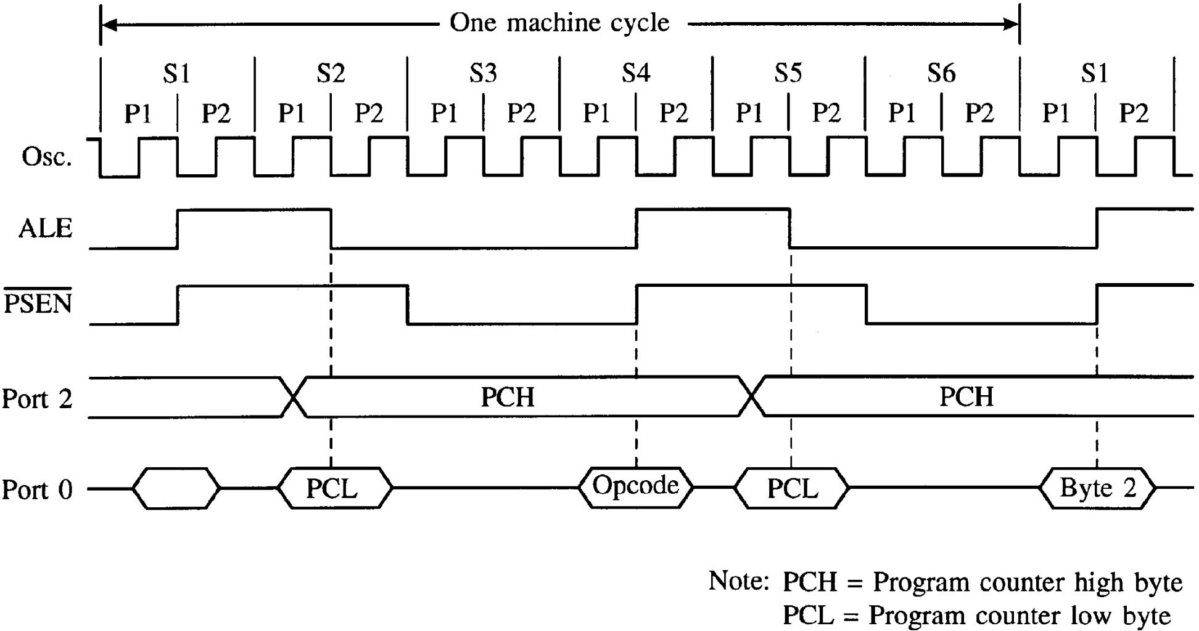
ĐH Bách Khoa - ĐHQG TP.HCM
- chithong@hcmut.edu.vn
FIGURE 2–10 Read timing for external code memory
Timing diagram for external CODE memory access
Ref. I. Scott Mackenzie
37

Slide 38

Accessing External Data Memory
External code memory is RAM enabled by /RD & /WR
signals using MOVX instruction.
Port 0 & Port 2 are unavailable as I/O ports.
Port 0 is AD0-AD7 bus & Port 2 is A8-A15 bus.
Ref. I. Scott Mackenzie
38

Slide 39
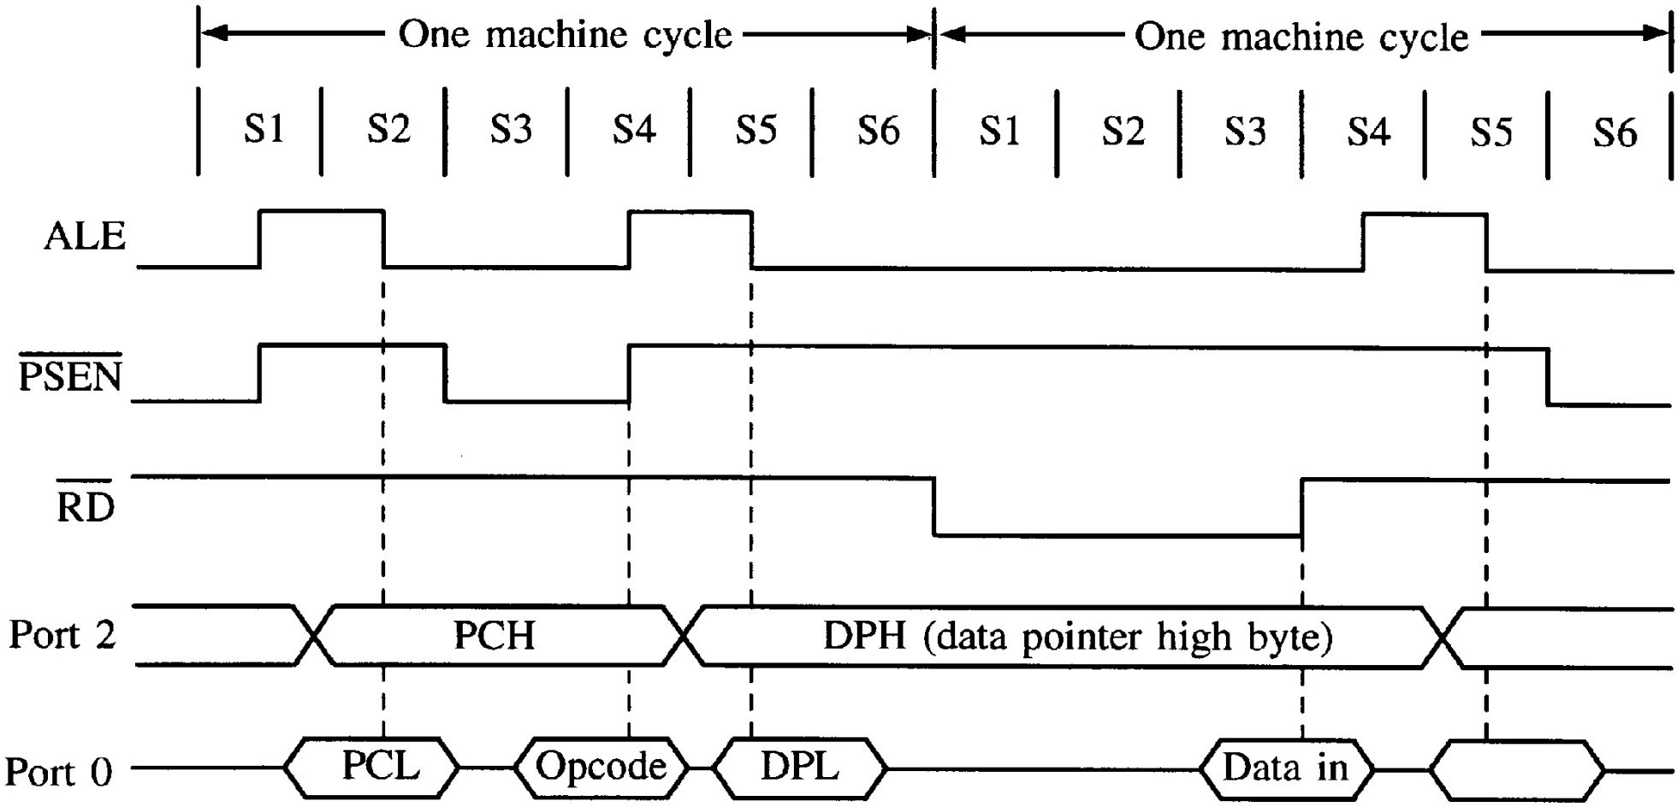
ĐH Bách Khoa - ĐHQG TP.HCM
- chithong@hcmut.edu.vn
FIGURE 2–11 Timing for MOVX instruction
For external DATA memory
Ref. I. Scott Mackenzie
39

Slide 40
Address Decoding
If multiple ROMs and/or RAMs are interfaced to an 8051,
address decoding is required.
Typically, a decoder IC such as 74HC138 is used with its outputs connected to the chop select (/CS) inputs on the memory ICs.
Remember enable lines: /PSEN for code memory (ROM) and
/RD & /WR for data memory (RAM)
Accommodate up to 64KB each of ROM and RAM
Ref. I. Scott Mackenzie
40

Slide 41
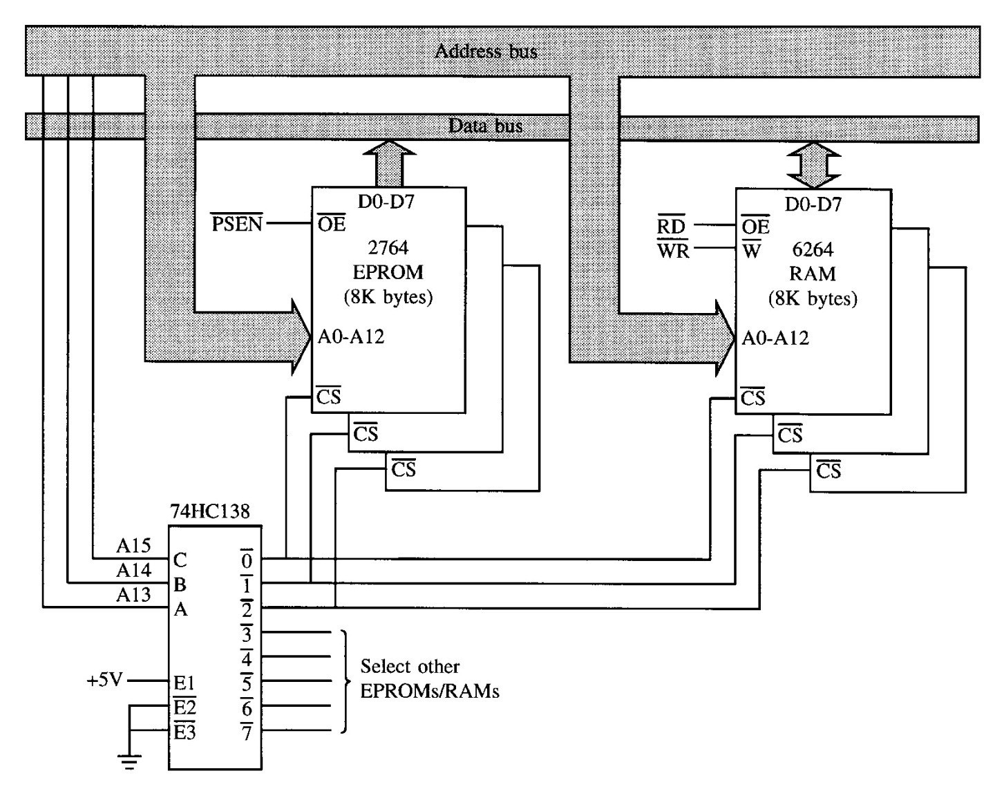
ĐH Bách Khoa - ĐHQG TP.HCM
- chithong@hcmut.edu.vn
FIGURE 2–13 Address decoding
ROM
RAM
Ref. I. Scott Mackenzie
41

Slide 42
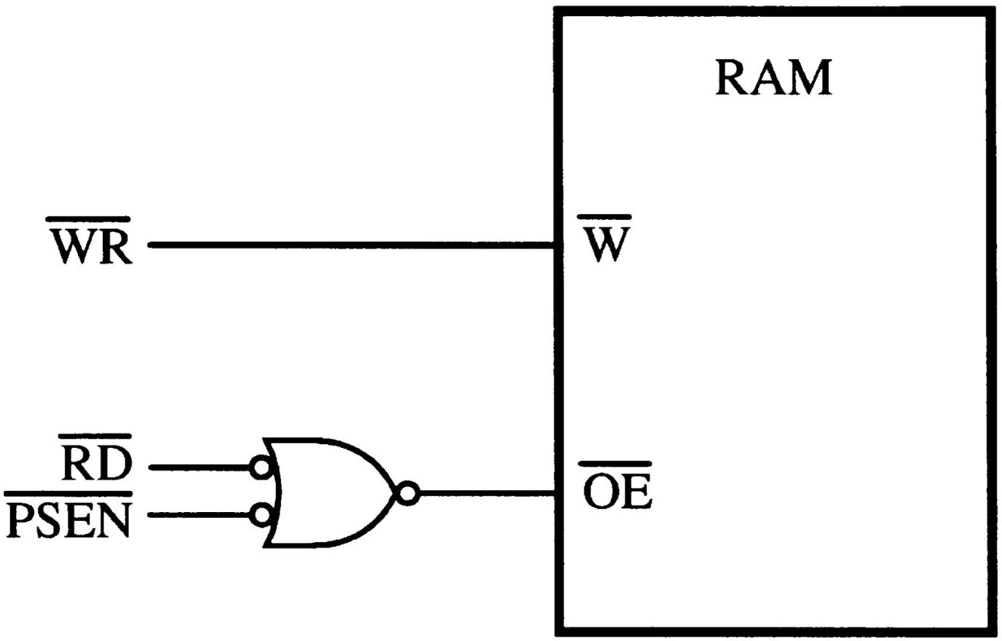
Overlapping the External Code and Data Spaces
o A RAM can occupy code and data memory space by using the following circuit.
For external CODE and DATA memory
Ref. I. Scott Mackenzie
42

Slide 43
ĐH Bách Khoa - ĐHQG TP.HCM
- chithong@hcmut.edu.vn
Internal RAM
256 locations from address 00H to FFH
The content of one location is 8 bit.
Address
FFH 80H | Special Function Registers (SFRs)
7FH 30H | General Purpose RAM
2FH 20H | Bit Addressable RAM
1FH 00H | Register banks
Address
8-bit content
0 | 0 | 0 | 0 | 1 | 1 | 1 | 0
32H
One memory location
43

Slide 44
General purpose RAM (30H-7FH)
Bit- addressable RAM
(20H-2FH)
Special function registers (SFRs) (80H-FFH)
Register banks (00H-1FH)
44

Slide 45
ĐH Bách Khoa - ĐHQG TP.HCM
- chithong@hcmut.edu.vn
General Purpose RAM
Address from 30H to 7FH
The content of one location is 8 bit.
Ex: MOV A,30H
This instruction moves (reads) the content of location 30H (NOT data 30H) to register A.
A 30H
Ex: MOV 31H,R4
This instruction moves (writes) the content of register R4 to location 31H.
31H
R4
45

Slide 46
General purpose RAM (30H-7FH)
Bit- addressable RAM
(20H-2FH)
Special function registers (SFRs) (80H-FFH)
Register banks (00H-1FH)
46

Slide 47
ĐH Bách Khoa - ĐHQG TP.HCM
- chithong@hcmut.edu.vn
Bit Addressable RAM
Address from 20H to 2FH
The content of one location is 8 bit.
Can read/write a byte or a bit
Ex: MOV 20H, A ; writes the content of register A to location 20H.
20H A
Ex: SETB 20H.0
or SETB 00H
20H
 |  |  |  |  |  |  | 1
Not affected
Ex: MOV C,31H
or MOV C, 26H.1
CY
26H
47

Slide 48
General purpose RAM (30H-7FH)
Bit- addressable RAM
(20H-2FH)
Special function registers (SFRs) (80H-FFH)
Register banks (00H-1FH)
48

Slide 49
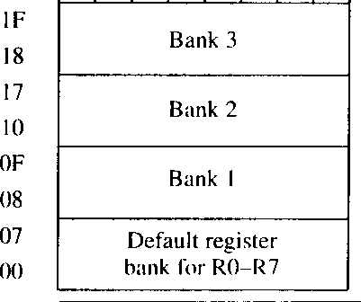
ĐH Bách Khoa - ĐHQG TP.HCM
- chithong@hcmut.edu.vn
Register Banks
4 banks: Bank 0 (default), Bank 1, Bank 2, and Bank 3
Change register bank by selecting bits RS1 and RS0 (in register PSW)
One bank includes 8 registers: R0 through R7
R0 of Bank 0 is location 00H
…
R7 of Bank 0 is location 07H
R0 of Bank 1 is location 08H
…
R7 of Bank 1 is location 0FH
R0 of Bank 2 is location 10H
…
R7 of Bank 2 is location 17H
R0 of Bank 3 is location 18H
…
R7 of Bank 3 is location 1FH
49

Slide 50

Register Banks – Your Turn!
R1 of Bank 0 is location ………
R5 of Bank 0 is location ………
R5 of Bank 1 is location ………
R1 of Bank 2 is location ………
R2 of Bank 3 is location ………
R6 of Bank 3 is location ………
50

Slide 51
ĐH Bách Khoa - ĐHQG TP.HCM
- chithong@hcmut.edu.vn
Register Banks
Ex: use default bank (Bank 0)
R5
≡
05H
MOV A, R5 =
Read the contents of register R5 into the accumulator
MOV A, 05H
Read the contents of location 05H into the accumulator
MOV R0, A
Read the contents of register A into register R0
=
MOV 00H, A
Read the contents of register A into location 00H
51

Slide 52
Register PSW (Program Status Word)
52

Slide 53
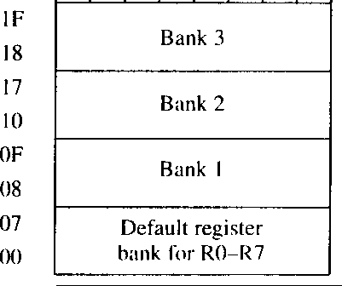
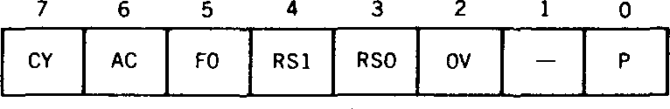
ĐH Bách Khoa - ĐHQG TP.HCM
- chithong@hcmut.edu.vn
Selecting Register Bank
The active bank is selected by bit RS1 (PSW.4) & RS0 (PSW.3)
RS1 | RS0 | Bank
0 | 0 | 0
0 | 1 | 1
1 | 0 | 2
1 | 1 | 3
Ex: MOV
PSW, #00010000B ; select bank 2
or SETB RS1
CLR RS0
Try it: Select bank 1
……………………..
……………………..
53

Slide 54
General purpose RAM (30H-7FH)
Bit- addressable RAM
(20H-2FH)
Special function registers (SFRs) (80H-FFH)
Register banks (00H-1FH)
54

Slide 55
ĐH Bách Khoa - ĐHQG TP.HCM
- chithong@hcmut.edu.vn
Special Function Registers (SFRs)
SFRs include register A, B, PSW, P0, P1, P2, P3, DPTR, TMOD, SCON …
All SFRs are accessible by name and direct address.
Both of them must be coded as direct address
Ex: MOV P1, A ; Output register A to Port 1 MOV 90H, A ; same
€ Same opcode: F5 90 Ex: MOV R1, ACC
MOV R1, 0E0H
€ Same opcode: A9 E0 Ex: MOV R1, ACC
MOV R1, A
€ Same function BUT different opcodes (A9 E0 vs. F9)
Try it: Input Port 2 to register A ……………………………
55

Slide 56
References
I. Scott Mackenzie, The 8051 Microcontroller
Các tài liệu trên Internet không trích dẫn hoặc không ghi tác giả
56

